Slide 1
Syllabus – Unit 4 -Using Forms and Gathering Input
Creating contact us form
Create a controller file for the contact page that will contain methods for displaying the contact form view and for processing the data from the contact form
Create the contact form view
Add the routes for displaying the form and sending the message
Create a form request that handles all the validation logic away from your main controllers
Create a recipient model class that will reference name and email settings in a separate config file to determine where the contact form information is sent
Create a notification that allows us to format the mail message we will receive
Add or check the email settings in your .env file

Slide 2
Validating user input
To learn about Laravel's powerful validation features, let's look at a complete example of validating a form and displaying the error messages back to the user.
By reading this high-level overview, you'll be able to gain a good general understanding of how to validate incoming request data using Laravel

Slide 3
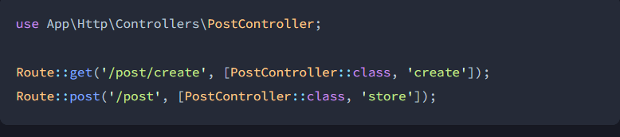
Defining The Routes
First, let's assume we have the following routes defined in our routes/web.php file:

Slide 4
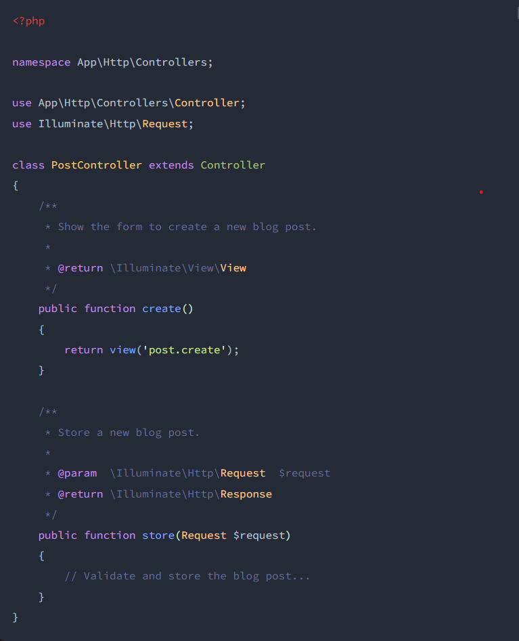
Creating The Controller
Next, let's take a look at a simple controller that handles incoming requests to these routes. We'll leave the store method empty for now:

Slide 5
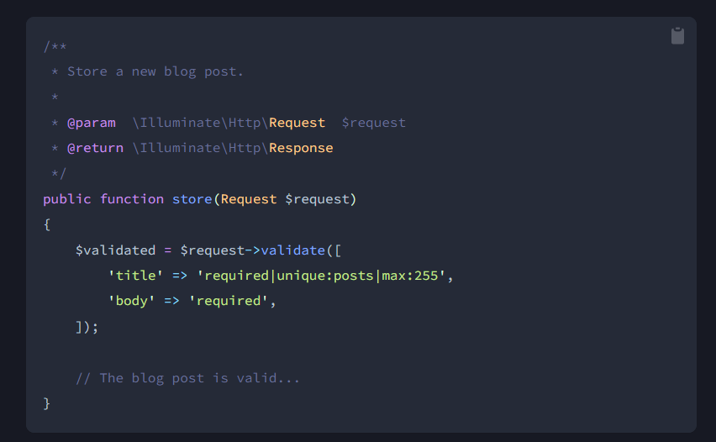
Writing The Validation Logic
Now we are ready to fill in our store method with the logic to validate the new blog post. To do this, we will use the validate method provided by the Illuminate\Http\Request object. If the validation rules pass, your code will keep executing normally; however, if validation fails, an Illuminate\Validation\ValidationException exception will be thrown and the proper error response will automatically be sent back to the user.
If validation fails during a traditional HTTP request, a redirect response to the previous URL will be generated. If the incoming request is an XHR request, a JSON response containing the validation error messages will be returned.
To get a better understanding of the validate method, let's jump back into the store method:

Slide 6
Displaying The Validation Errors
So, what if the incoming request fields do not pass the given validation rules? As mentioned previously, Laravel will automatically redirect the user back to their previous location. In addition, all of the validation errors and request input will automatically be flashed to the session.
An $errors variable is shared with all of your application's views by the Illuminate\View\Middleware\ShareErrorsFromSession middleware, which is provided by the web middleware group. When this middleware is applied an $errors variable will always be available in your views, allowing you to conveniently assume the $errors variable is always defined and can be safely used. The $errors variable will be an instance of Illuminate\Support\MessageBag. For more information on working with this object, check out its documentation.
So, in our example, the user will be redirected to our controller's create method when validation fails, allowing us to display the error messages in the view:

Slide 7
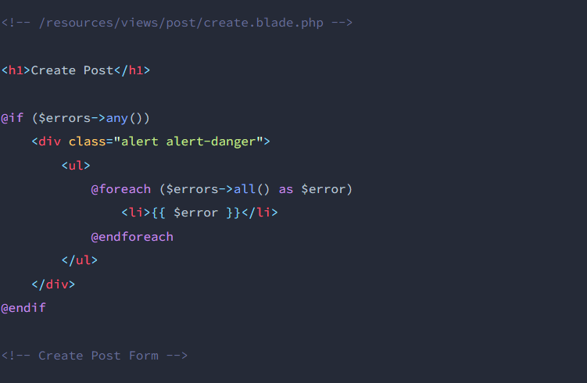
Displaying The Validation Errors

Slide 8
Laravel uses free feature-rich library SwiftMailer to send emails. Using the library function, we can easily send emails without too many hassles. The e-mail templates are loaded in the same way as views, which means you can use the Blade syntax and inject data into your templates.
Sending email

Slide 9
Sending email
The following table shows the syntax and attributes of send function − Syntax void send(string|array $view, array $data, Closure|string $callback) Parameters $view(string|array) − name of the view that contains email message $data(array) − array of data to pass to view $callback − a Closure callback which receives a message instance, allowing you to customize the recipients, subject, and other aspects of the mail message Returns nothing Description Sends email.

Slide 10
Creating a file uploader, Validating a file uploader,
. Install Laravel Project
First, open Terminal and run the following command to create a fresh laravel project:
composer create-project --prefer-dist laravel/laravel file-upload-laravel
or, if you have installed the Laravel Installer as a global composer dependency:
laravel new file-upload-laravel
2. Configure Database Details:
After, Installation Go to the project root directory, open .env file, and set database detail as follow:

Slide 11
Creating a file uploader, Validating a file uploader,
5. Create Routes
Go to routes/web.php and create two routes. First, the route handles the form creation, and the second route stores the file in the MySQL database.
Route::get('/file', [FileController::class, 'index']);
Route::post('/file', [FileController::class, 'store'])->name('file');
6. Create Blade File
In this step, you need to create a blade view file. Go to resources/views and create one file name fileUpload.blade.php:
Before starting the application you need to run this command to access all uploaded images ignore this command if you don't upload in a public disk.
php artisan storage:link
The public disk is intended for files that are going to be publicly accessible. By default, the public disk uses the local driver and stores these files in storage/app/public. To make them accessible from the web, you should create a symbolic link from public/storage to storage/app/public.

Slide 12
Creating a file uploader, Validating a file uploader,
3. Create Model and Configure Migration
php artisan make:model File -m
Create a Model in laravel, It holds the data definition that interacts with the database.
4. Create File Controller
Now, you need to create a controller name FileController. Use the below command and create a Controller:
php artisan make:controller FileController
Next, let’s add a method in FileController.php which is located under the app/Http/Controllers folder.
The first method renders the view via FileUpload controller, and the store() method checks the validation, be it required, mime type, or file size limitation. This method also stores the file into the storage/public/files folder and saves the file name and path in the database.

Slide 13
Thank You

